Slide 1
Su-better-way
Lucien

Slide 2
Mind mapping
New York
Population
Safety
Weapon
Subway
Commute
Speed
Comfort
Music

Slide 3
How might we...
How might we imporve safety of the subway system?
How might we imporve the experience for passengers to take subways? (Phisically and emotionally)

Slide 4
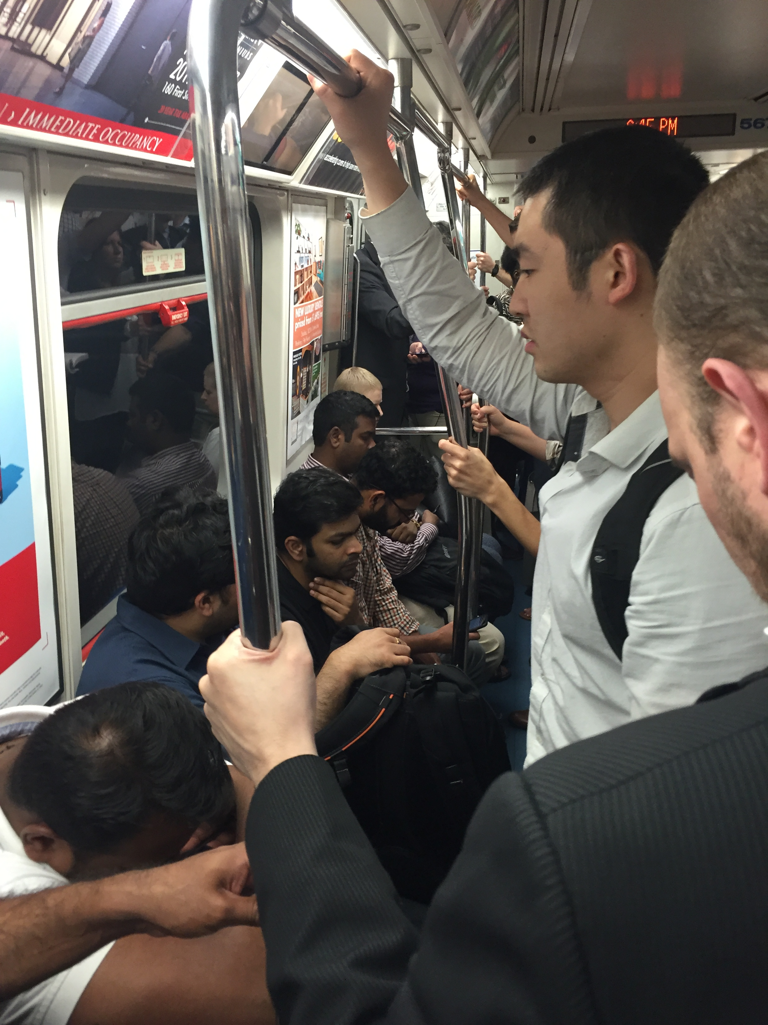
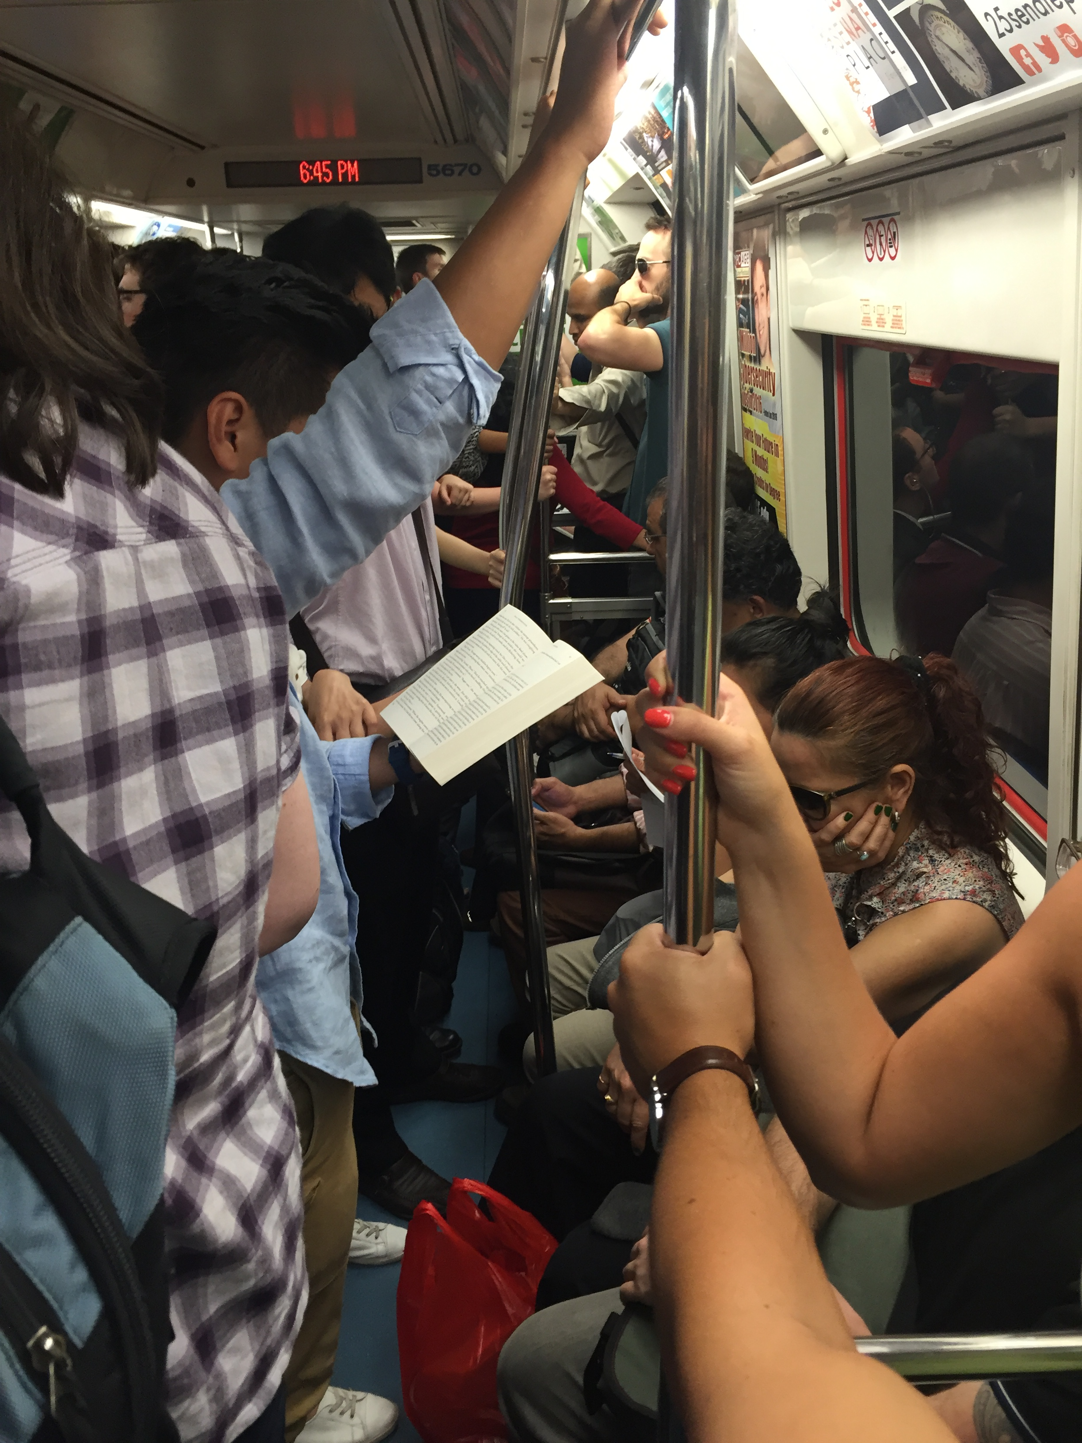
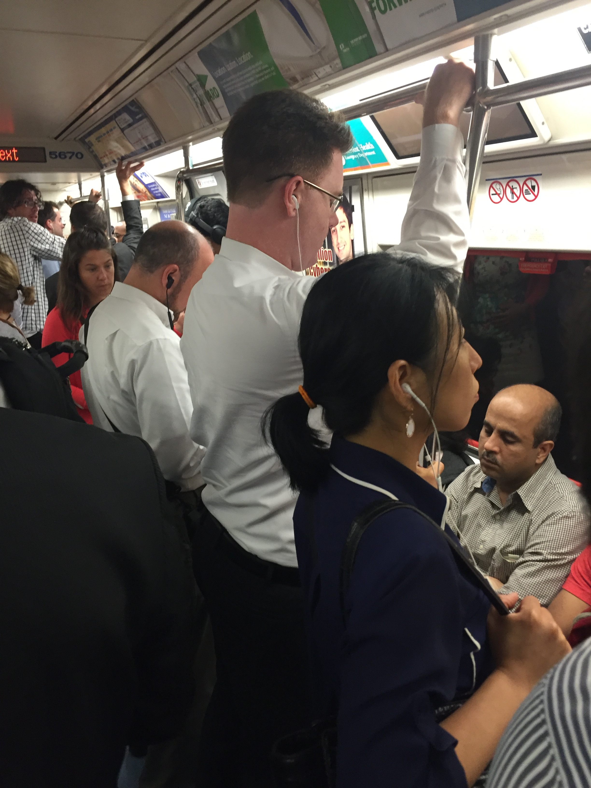
Observation

Slide 5
Observation
Backpacks
Earphones
Books

Slide 6
Jack, 25, Brooklyn
Office staff working in a company in Manhattan
Activities - Wearing backpacks, earphones all the time. Take subways to work every day alone. Enjoy going to bars with friends after work.
Attitudes - Always feel motivated for work. Happy in the morning for most of the days. Jack likes meeting new people and friends. He feels subconciously afraid of terrorist attacks or people suicides when riding a subway. He is also a little terrified of taking subways late at night.
Aptitudes - Adventurer, enthusiastic for club music, crazy out of work.
Motivations - Needs to take subway to work every day to save money. Environment-friendly. Persue a more stable, safer and more interesting life.
Skills - High-tech fan, interested in collecting old stuff.
Goals - To live a happy life, save money and get promoted in work.

Slide 7
Jack, 25, Brooklyn
One day, Jack got up late and he had to go to work immediately, so he went to take a subway. However, it took so much time going to the platform. He likes listening to music when taking the subway. But it was so noisy even after he put on the headphone.
Because of being late for work, Jack had to work late in the night. So when he went home, it's getting pretty late, like around 12am. Jack had heard that the subways are pretty dangerous late at night so he didn't want to go home by subway. So Jack decided to go home by Uber. However, it took him about 30 dollars. “Jesus, I wish only if the subway is safe!” Jack thought.

